Slide 1
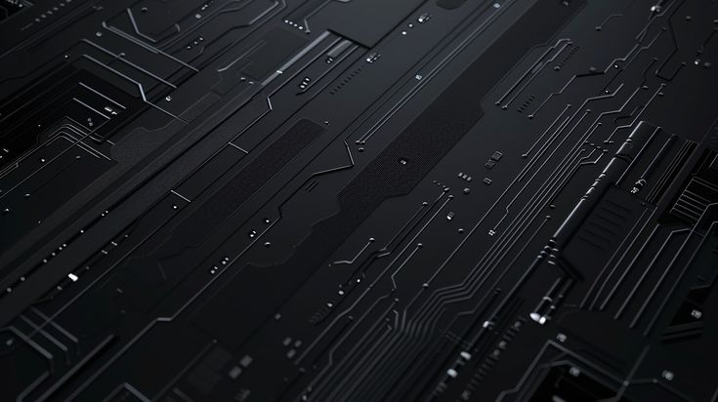
THE
DARK WEB
BENEATH THE SURFACE OF THE INTERNET
Crafted in the Shadows By: Beena Khan - 2520268

Slide 2
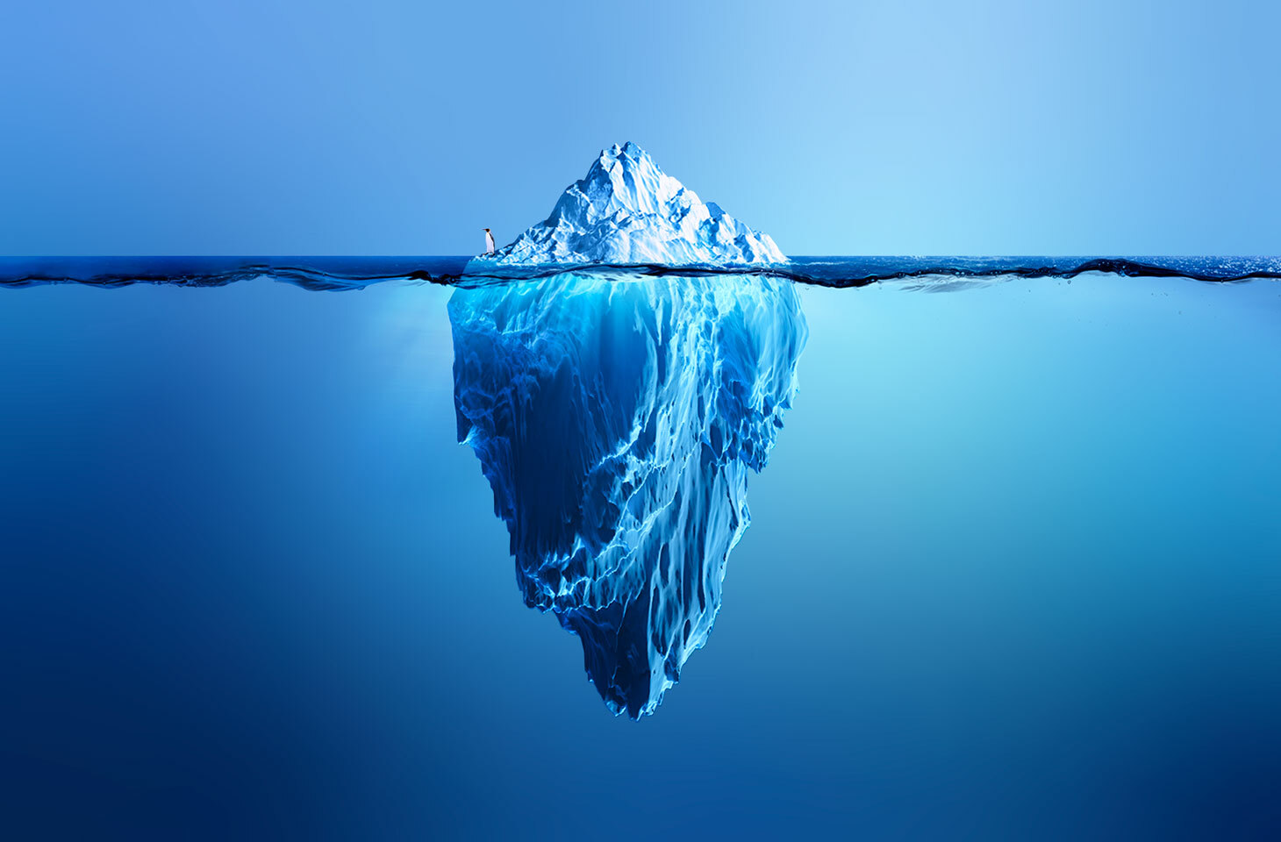
The internet you see is just the tip of the iceberg… Welcome to the part that hides in the shadows — The Dark Web.

Slide 3
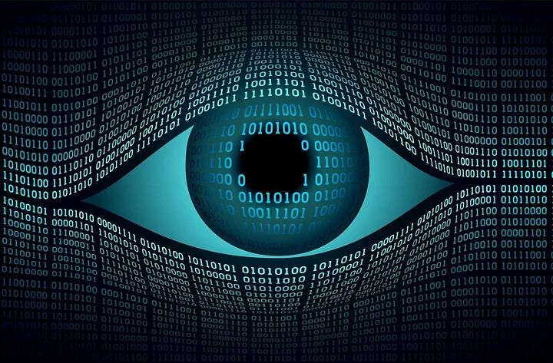
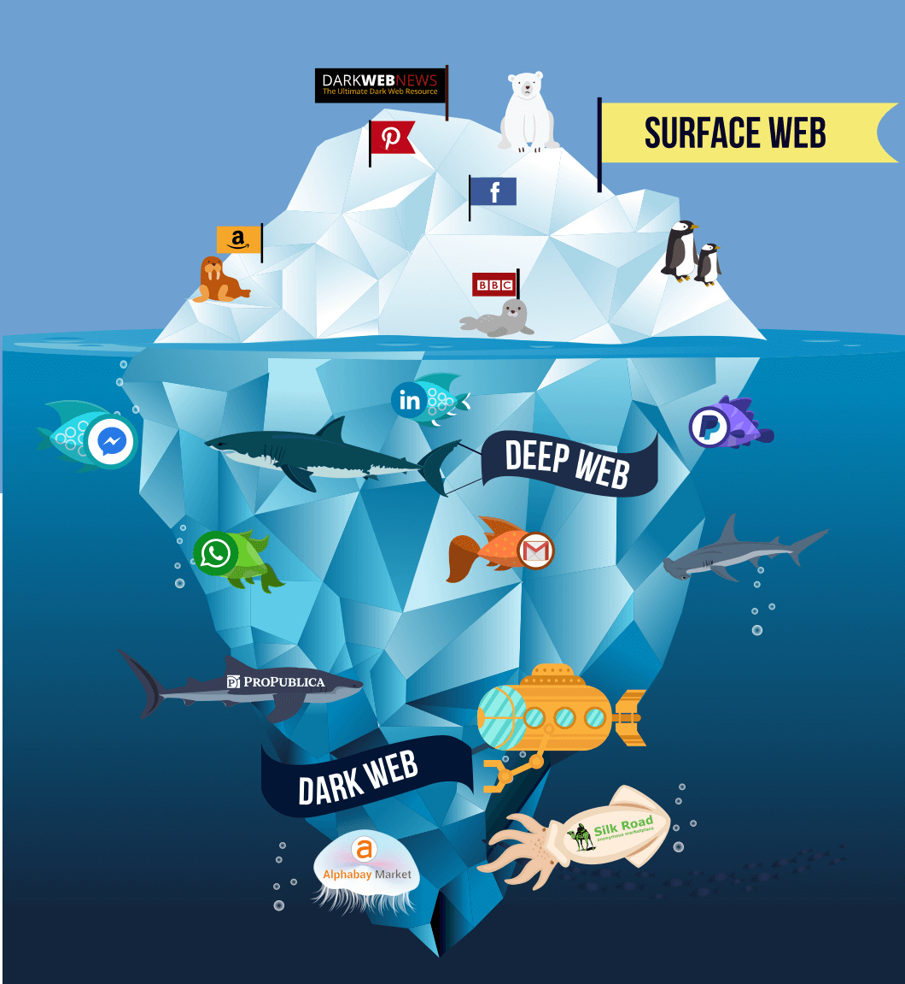
THE INTERNET ICEBERG
Surface Web: What we use daily (Google, YouTube, social media)
Deep Web: Private databases, academic sites, medical records
Dark Web: Encrypted networks, hidden from search engines

Slide 4
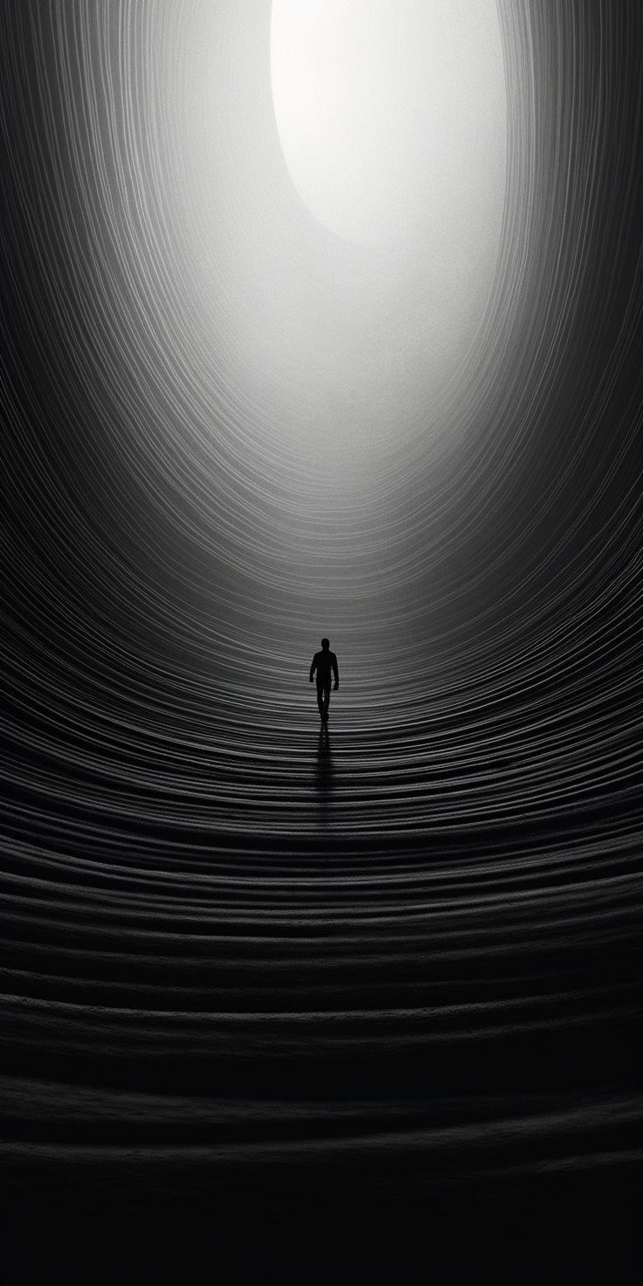
A hidden network of sites only accessible through special software like Tor. It’s a place of anonymity, secrecy, and hidden communities.

Slide 5
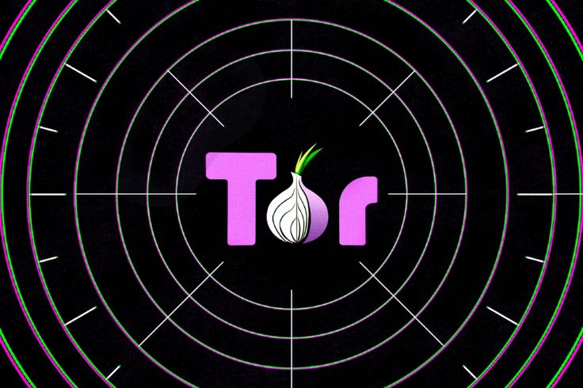
HOW PEOPLE ACCESS IT?
onion websites — invisible to normal browsers
Tor (The Onion Router) — hides user identity
Encrypted traffic — nearly impossible to trace ADD ONE MORE
Layered relays (volunteer-operated nodes)

Slide 6
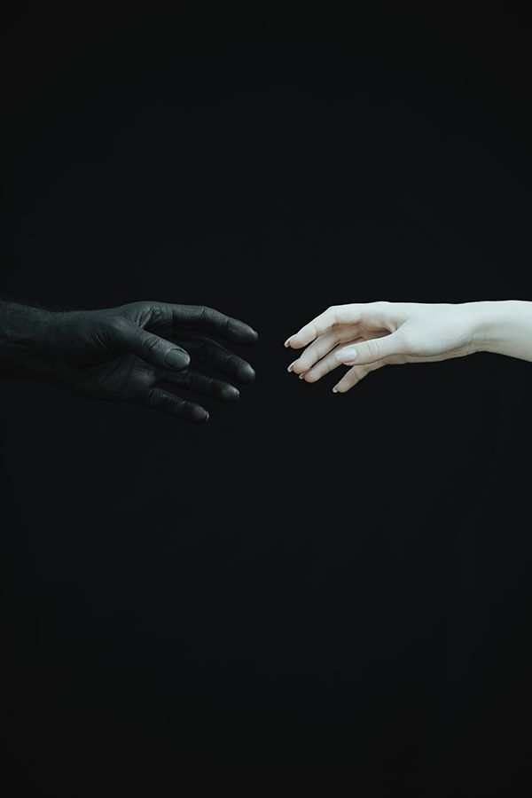
Why It Exists
Free speech in censored countries
Journalists & whistleblowers use it safely
But also… criminals and hackers thrive there
“Where freedom and danger meet.”

Slide 7
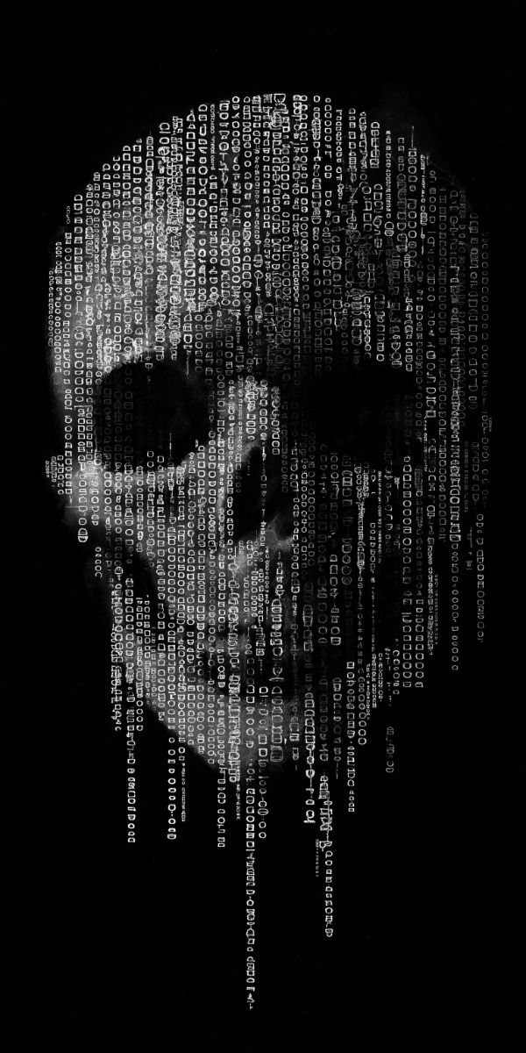
THE DARK SIDE
Illegal marketplaces (drugs, weapons, fake ID’s)
Data leaks and stolen info
Hacking services
Scams and cybercrimes rings

Slide 8
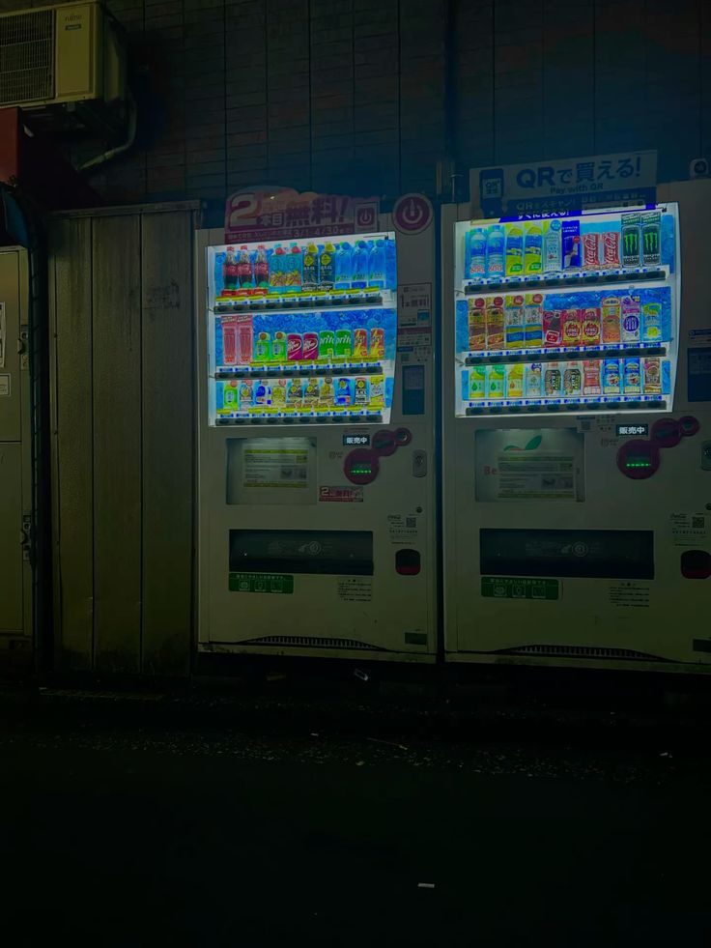
THE HIDDEN MARKETS
The first big one: Silk Road (2011–2013)
Others rose and fell — seized by the FBI
Still, new ones appear… like ghosts in the system

Slide 9
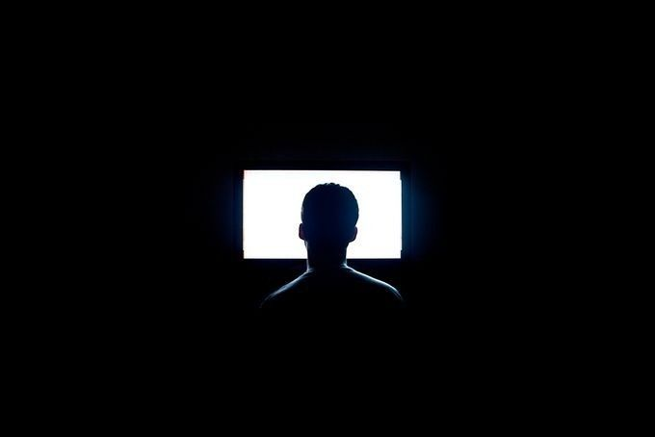
THE GOOD SIDE
Activists avoid government tracking
Reporters talk to secret sources
Privacy lovers protect their data
“The Dark Web isn’t only evil — it’s also a shield.”

Slide 10
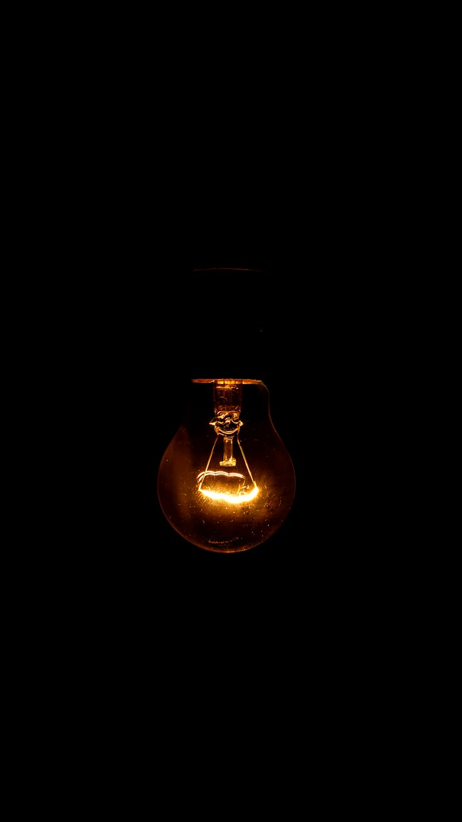
WHAT YOU CAN FIND LEGALLY?
Hidden libraries
Independent news sites
Anonymous forums
Dark web versions of legit sites(like proton mail or BBC )

Slide 11
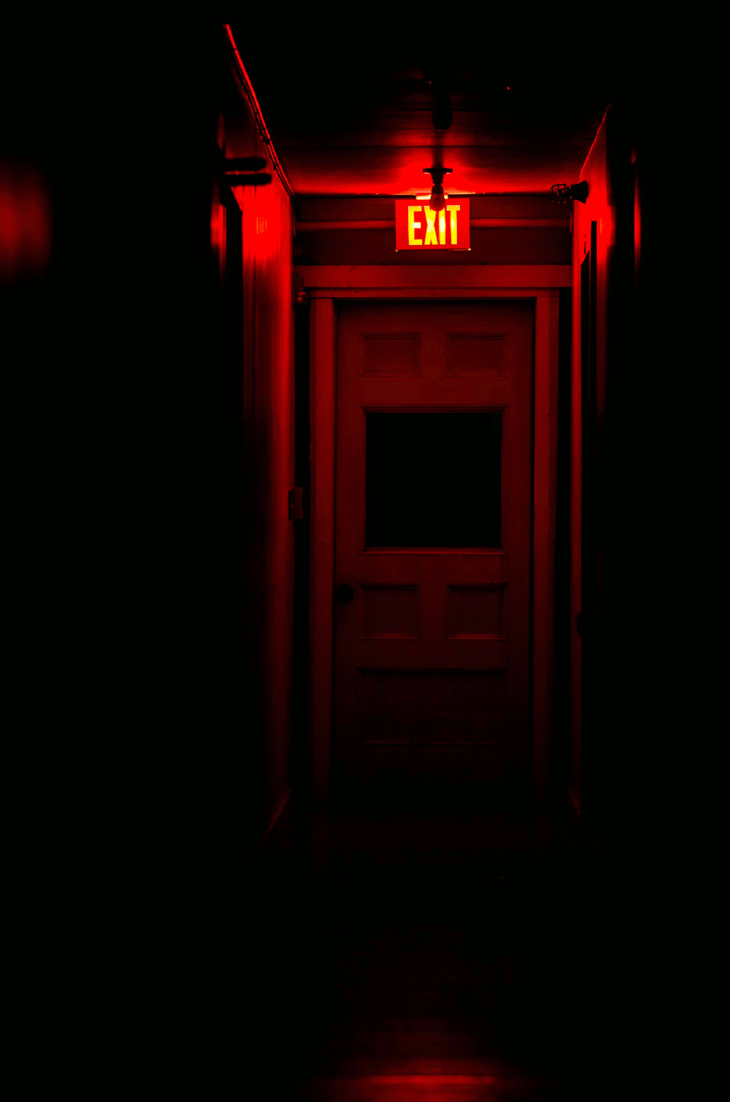
DANGERS LURKING THERE..
Malware & viruses
Scammers posing as sellers
Law enforcement traps
Traumatic or disturbing content
“Once you enter… it’s hard to unsee what’s inside.”

Slide 12

How It Stays Hidden
Layered encryption (like an onion)
Every relay hides your real IP
Designed for privacy — not discovery

Slide 13
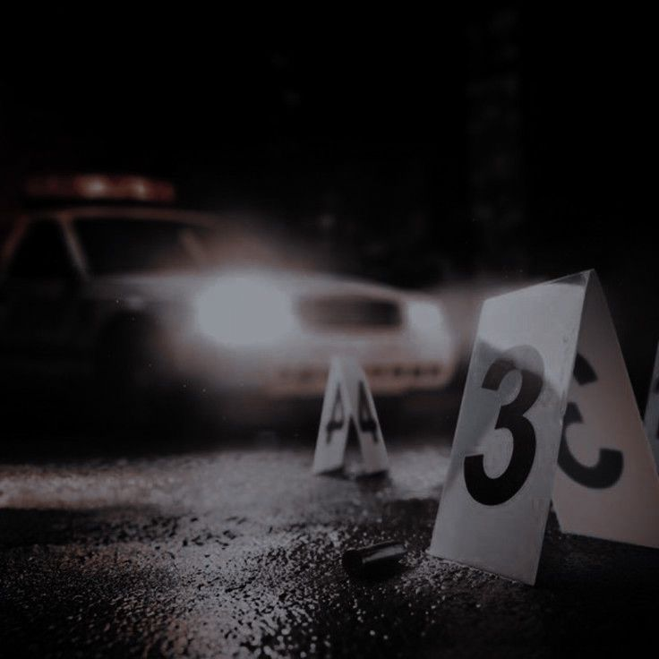
LAW & ORDER
FBI & Interpol hunt major networks
Seizures and sting operations
But for every site taken down… another one rises.

Slide 14
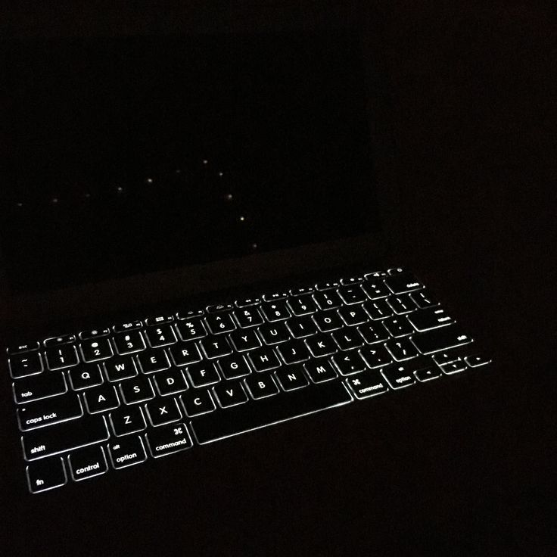
THE SHADOW BENEATH THE WEB
“The Dark Web is not just a place — it’s an idea. Freedom and fear intertwined. The deeper you go, the less you know who’s watching…”

Slide 15

End Of Transmission
Connection Terminated
Trace: Unknown
Source: Unhidden Note
“the web you know is only the beginning”

